Slide 1

CRYPTO Price prediction and Sentimental Analysis
MA981: DISSERTATION
Name: Hassan Kaleem
Supervisor: Peter Higgins

Slide 2
What is Bitcoin?
Bitcoin is a new type of digital money as know as cryptocurrency.
You can store it, exchange it, and make payments with it.
The key to what makes Bitcoin different from national currencies like the US Dollar, the Euro or the Japanese Yen lies in its decentralized structure.
Its has limited supply of 21 Million

Slide 3
Key Research Questions
Identify if bitcoin price will recover from the 21st July 2021 market dip or not.
Train machine learning model to predict the closing price of bitcoin
Identify good performing machine learning models.

Slide 4
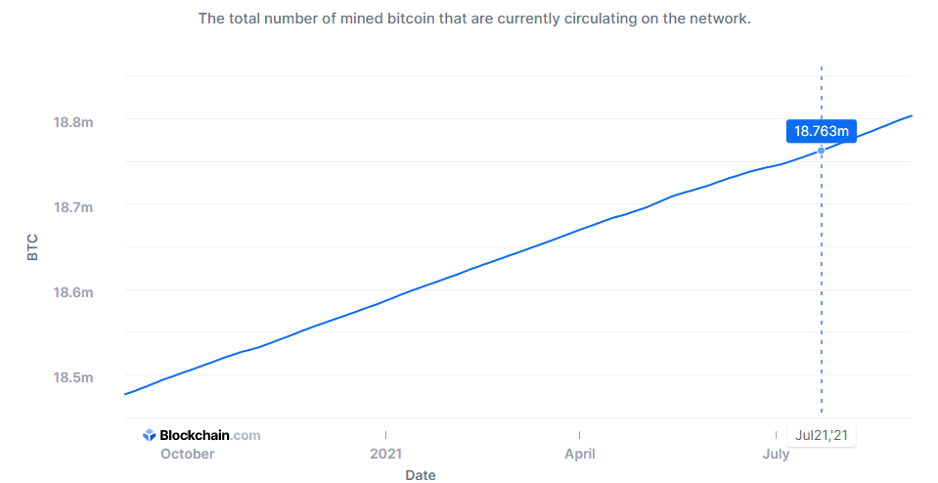
Total Circulating Bitcoins on 21 July

Slide 5
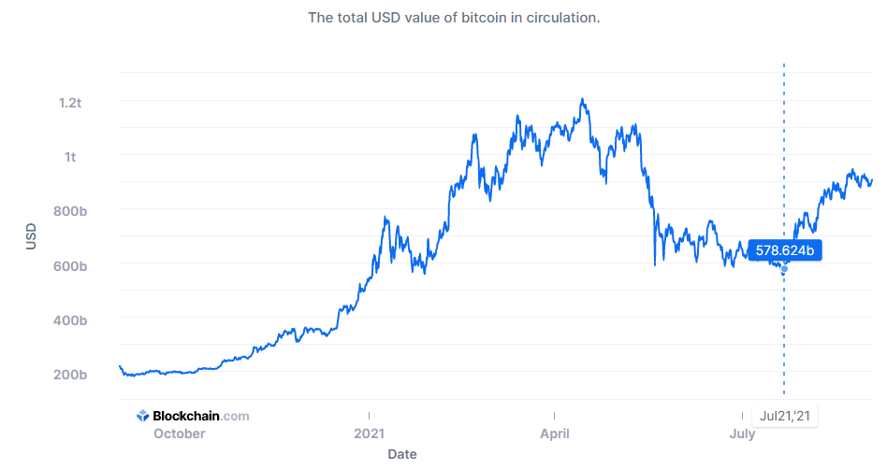
Market Cap of Bitcoin on 21 July

Slide 6
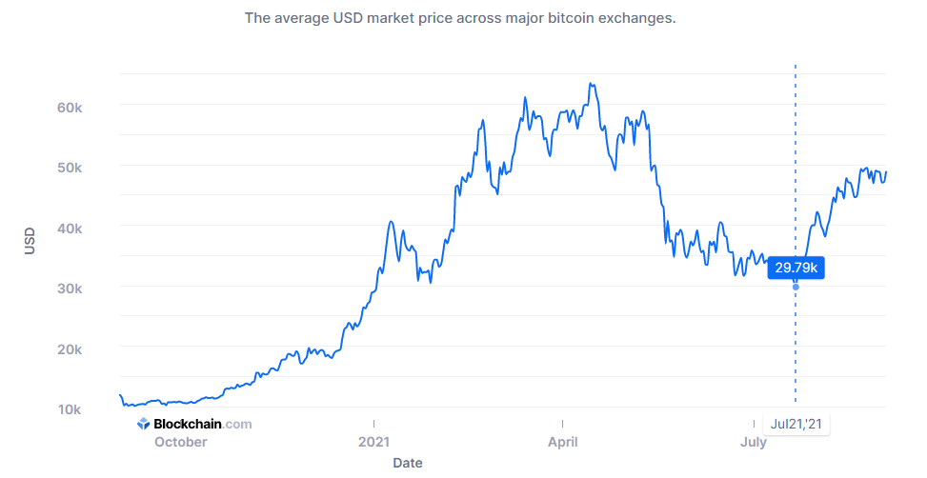
Market Price (USD) 21 – July- 2021 DIP

Slide 7
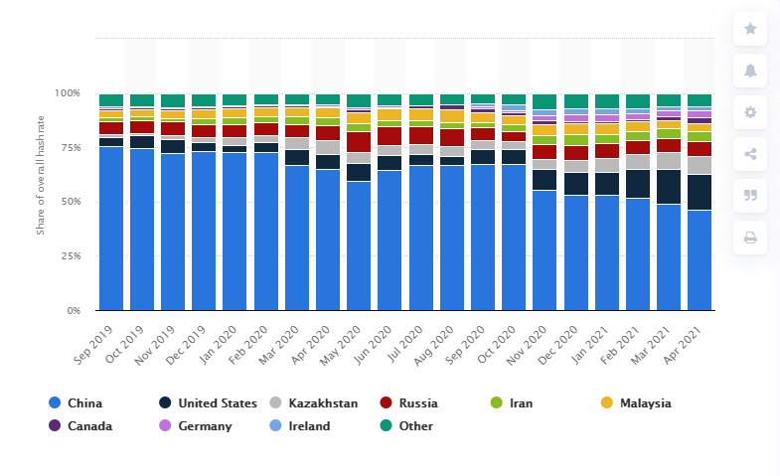
Share of overall Hash rate 2019 - 2021

Slide 8
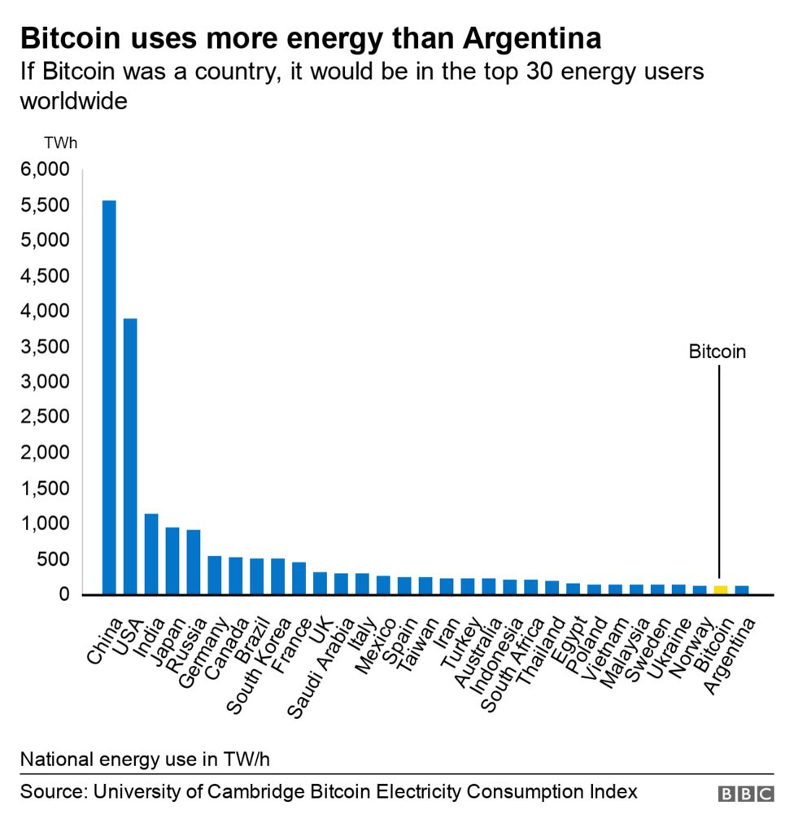
Energy Consumption of Bitcoin

Slide 9
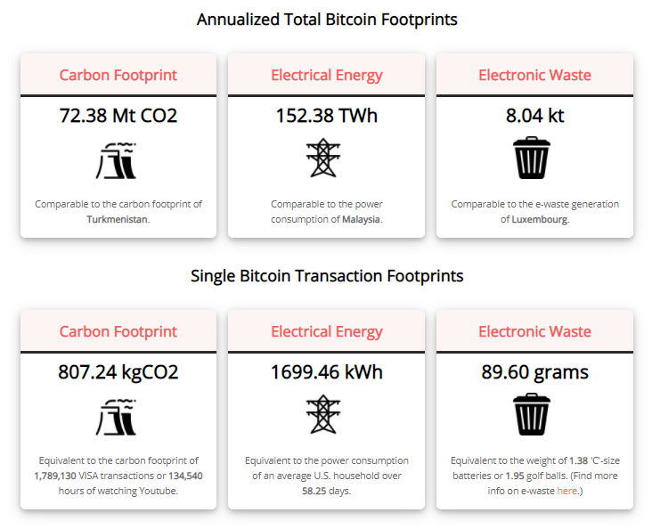
Bitcoin Footprints

Slide 10
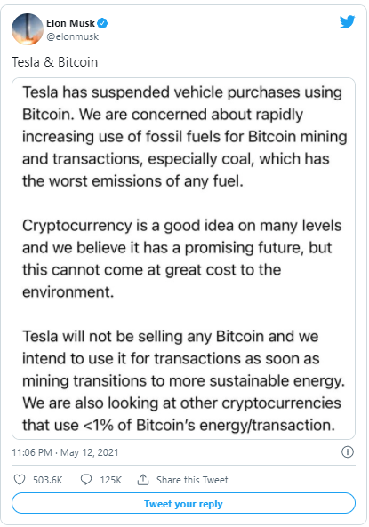
Why Sentimental Analysis ?

Slide 11
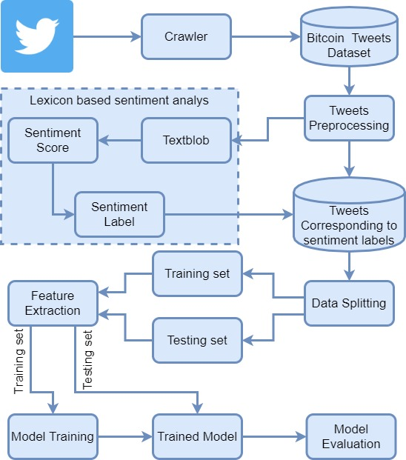
Model used for Sentimental Analysis

Slide 12
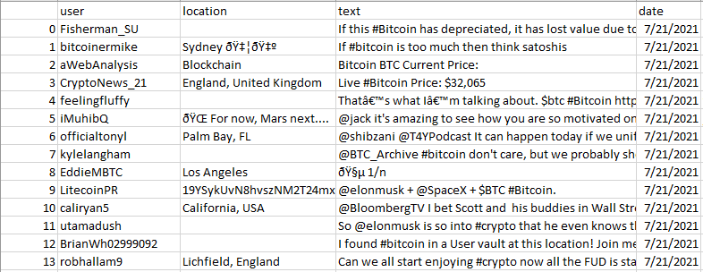
Tweets Dataset

Slide 13
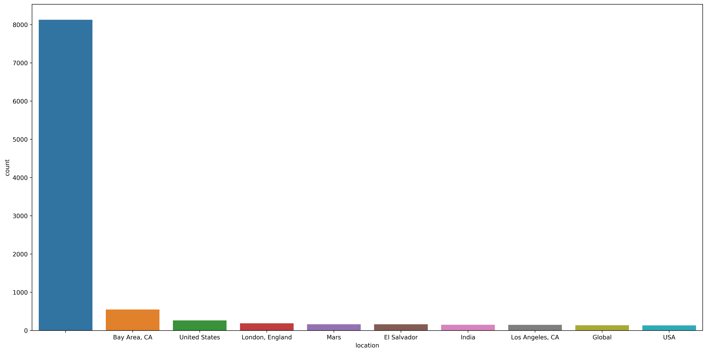
Distribution of Tweets based on location

Slide 14
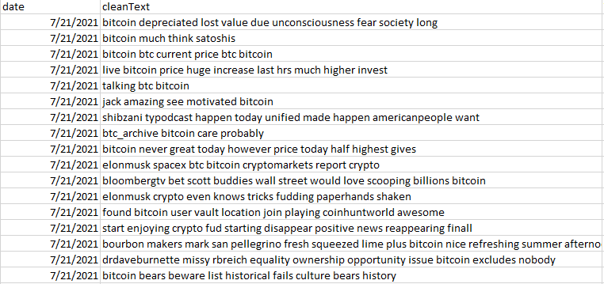
Preprocessed Tweets

Slide 15
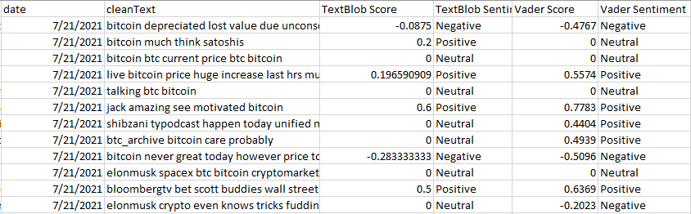
Labeled Tweets USING Textblod and Vader

Slide 16
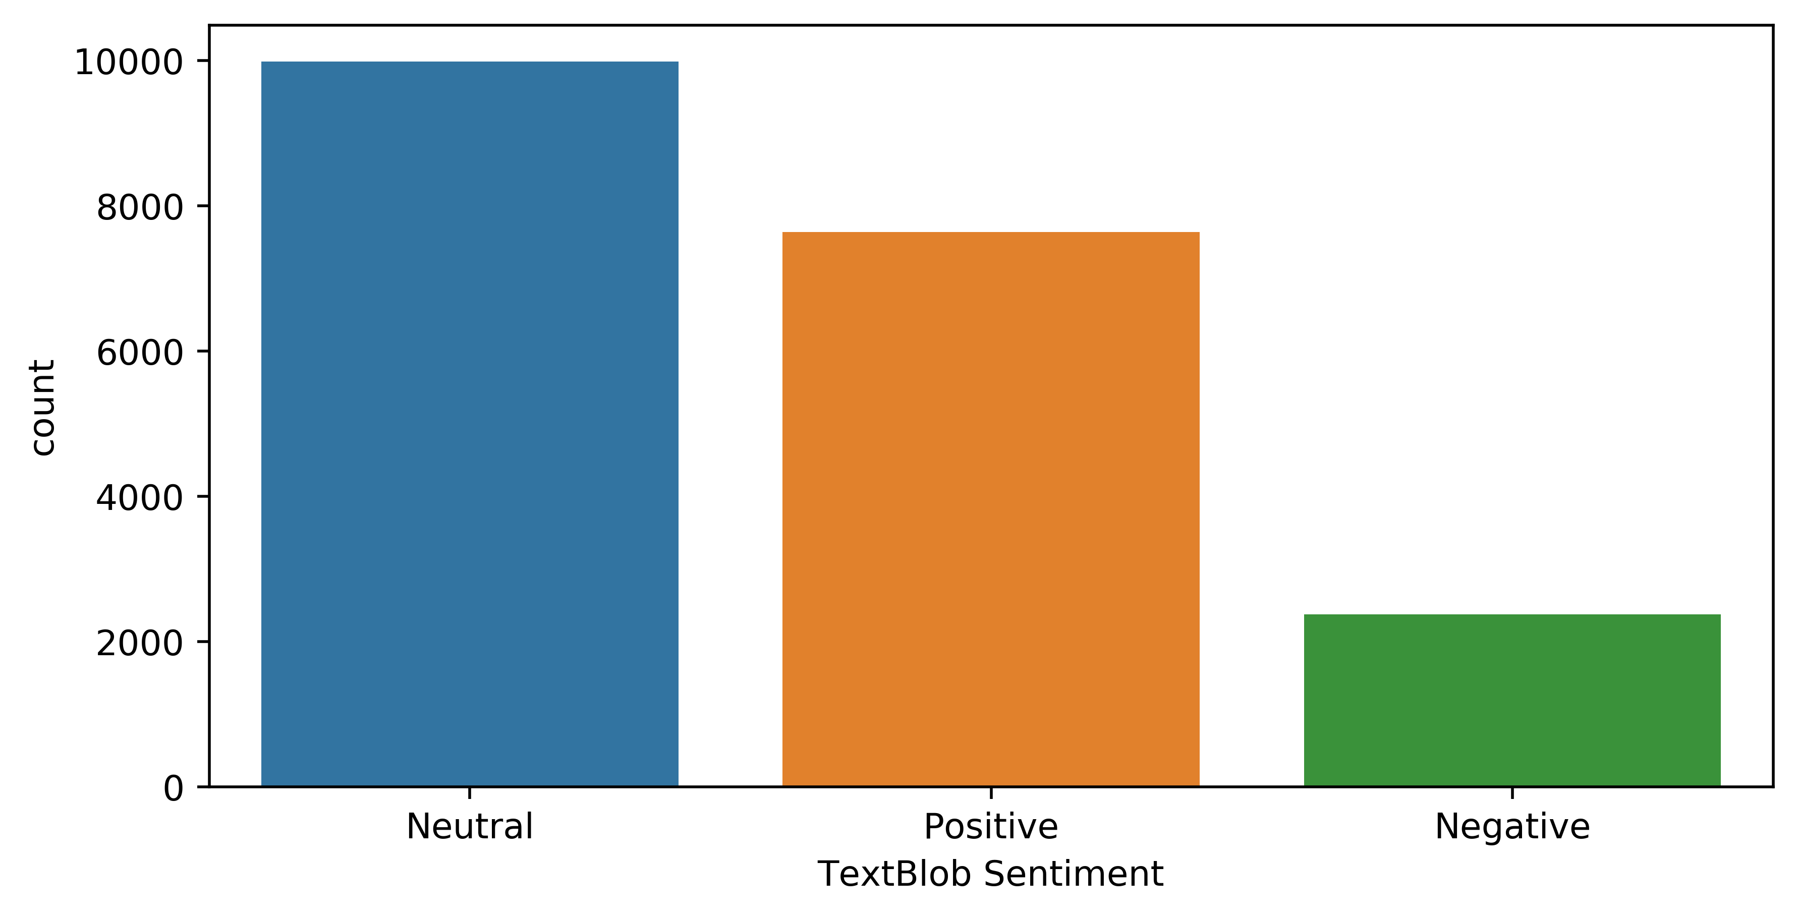
Sentiments using Textblod

Slide 17
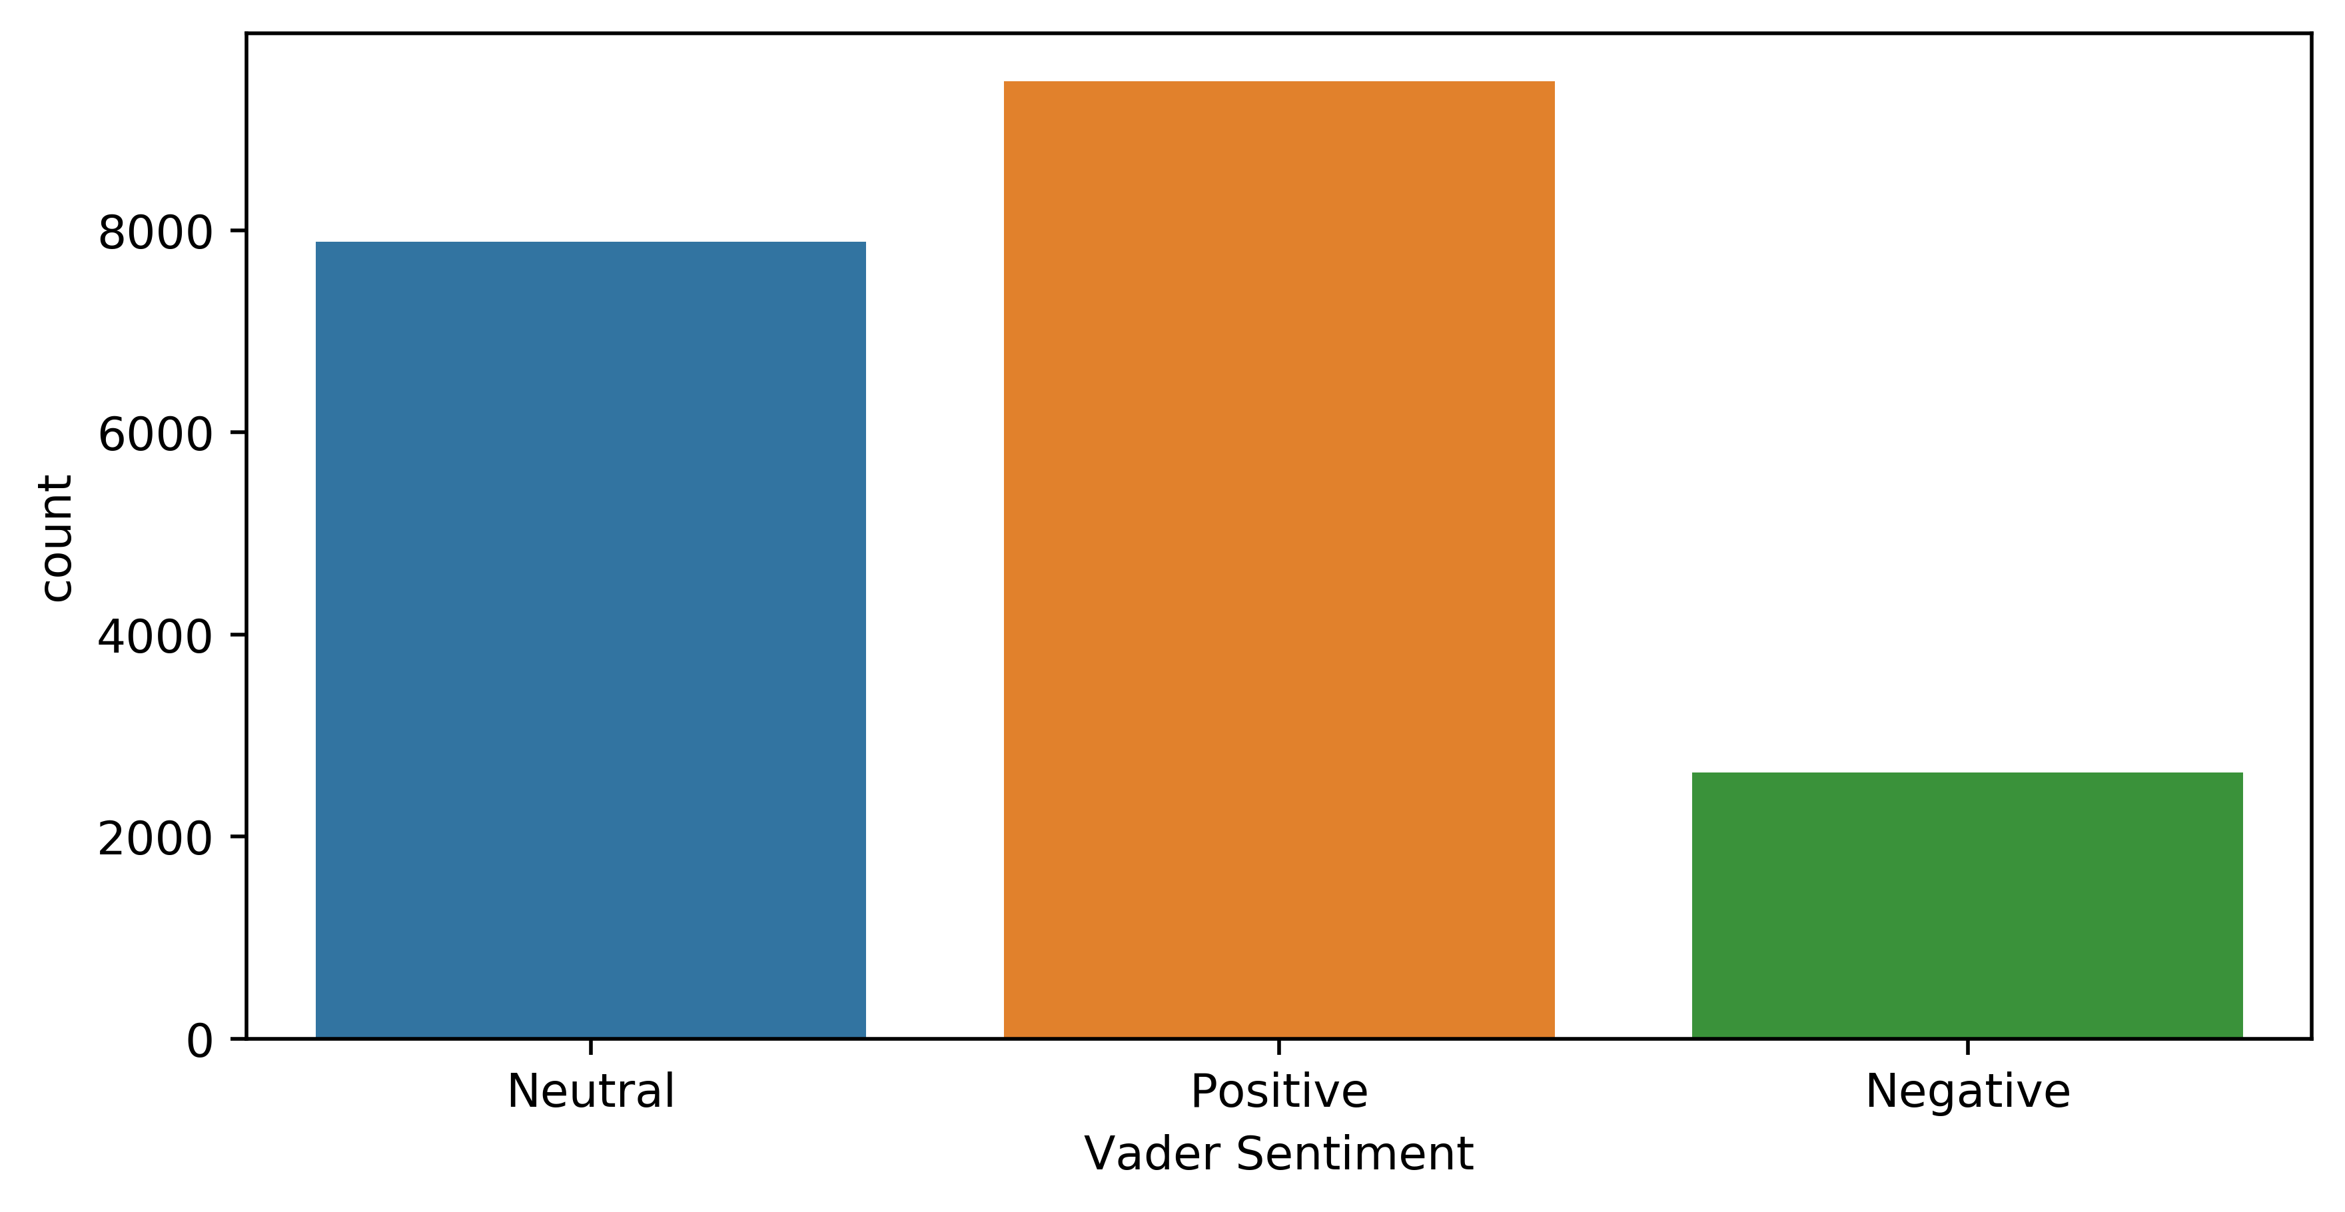
Sentiments using Vader

Slide 18
Closing Price Prediction of Bitcoin

Slide 19
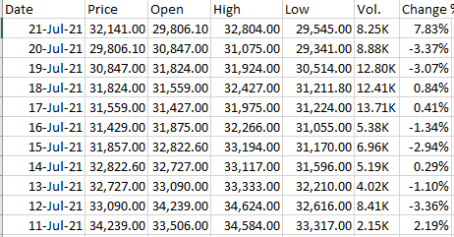
Historical data of bitcoin

Slide 20
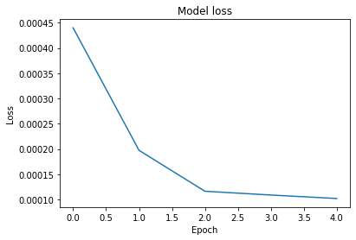
LSTM model Loss

Slide 21
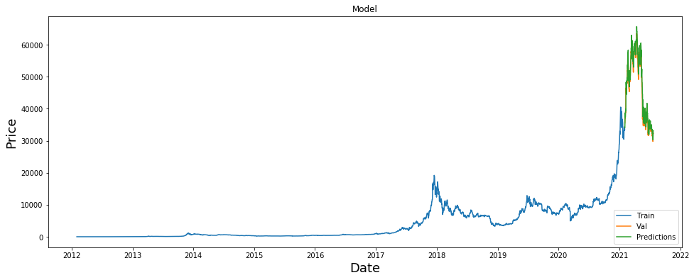

Results of LSTM

Slide 22
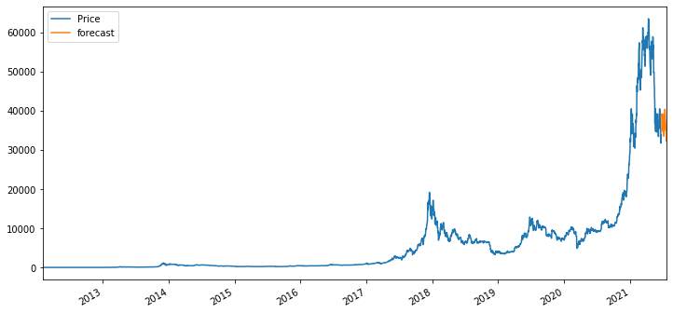

Results of Linear Regression

Slide 23
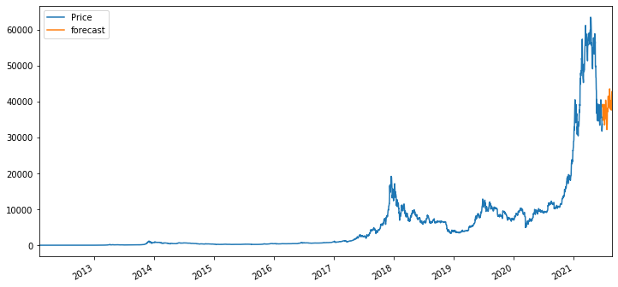

Results of random Forest

Slide 24
Conclusion
Bitcoin will recover from the dip based on sentimental analysis.
Random forest regressor had performed better than Linear regression and LSTM model.

